Slide 1
Q&A for Huawei Storage First Two Courses Boston Storage Solution Group May 2020
Notes:
Good morning, good evening and good afternoon everyone.
Welcome to Huawei Storage Technology Deep Dive.
This is Nelson Liao, the VP of Technologies at Santa Clara Storage Lab, which is also part of the Futurewei Boston Storage Center. It’s my honor to host today’s deep dive session. Before

Slide 2
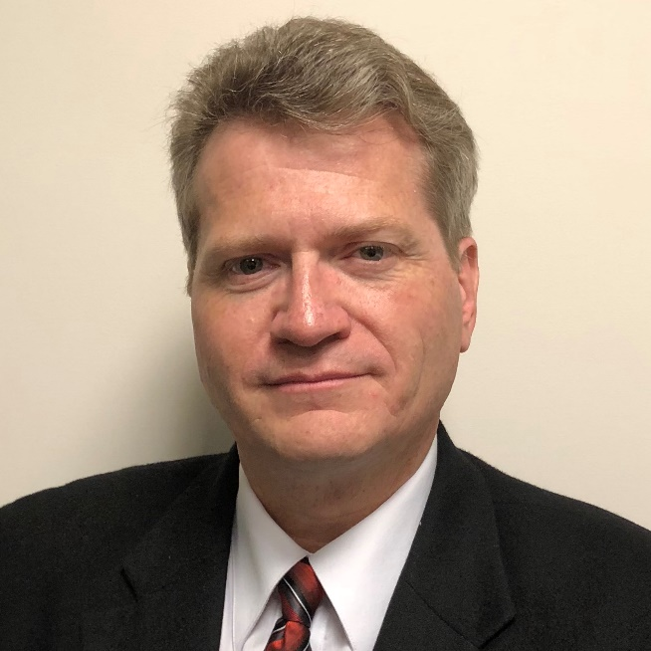
Key Domain & Key Project Experiences
Storage Systems, Product Engineering, Product Quality, Research & Development processes, Manufacturing, Robotics, Wireless, Power Engineering, Analytics
Software Engineering, Formal Analysis, Data Science, Design for Quality, Embedded/IoT
Portfolio Development, Systems Architecture, Solutions Design and Qualification
Market Development, Technical Pre-sales, Strategic and Corporate Development
Defining / Implementation of in time and on cost delivery processes for projects
Development / Deployment of cross-company / cross-department collaboration / partnership processes
Outstanding contributions
CTO of Huawei Storage (since 2018) and Data Management (since 2019), including identification of product requirement and strategy.
Leader of the Boston Storage Lab, where Huawei technologies have been developed for AIOps, Big Data Analytics, Data Lake, remote replication, active/active, ARM ecosystem enablement, and private cloud.
Support for European sales for large deals in France and Germany, including customers PSA, and Vodaphone.
Over forty (40) patents in Enterprise Storage
Kendell Chilton
ID: 00472362
Storage CTO
Speciality:
IT, Storage, Cloud, Database
Dept.:
Data Management and Storage
Communication Level :
CxO, CTO, VP, Analysts, Cloud Evangelist, IT Architect and Business Owners, Journalists, Media
Ready for Support
Familiar with North America, Europe, and Japan regions
Background: 1. 30+ years in IT R&D. 2. Storage expert (including 23 years at EMC, Symmetrix Chief Architect), 3. Degrees in Electrical Engineering, Computer Science, and Software Engineering. 3. Manufacturing and Engineering Vice President, VM Manufacturing
USA Passport. English.

Slide 3
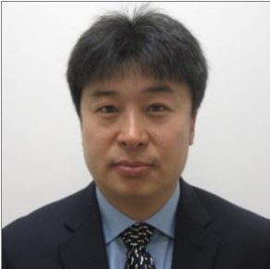
Key Project Experience
2020 France Orange group/OBS/OFR POC Customer Engagement, Business Development and Technical Support
2020 Atempo, Huawei and Futurewei Collaboration and Joint Innovation
2020 ICBC France GDPR-Compliant Backup and Archiving solution
2020 Audi Auto-Driving High Performance Storage Solution Development
2019 France Orange group, OFR and PSA Product Presentation for Intelligent Storage and Customer Engagement
2018 France IT Day, France ATOS Storage Workshop
2018 France PSA, France EDF Customer pre-sale support
Chairman of BIO-IT World 2019
Rich industry experience as Storage Architect with previous company(EMC). Support numerous customers across continents including Europe, Asian and US.
Chief Speaker of Huawei-Cornell Collaboration Workshop 2019.
Chairman of Huawei Storage American Workshop 2018
Tony Tang
ID: 00411685
Chief Architect and Senior Director
Speciality:
Enterprise Storage Solutions(NAS,Block,AFA,etc)
Distributed/SDS Solutions
Big Data/AI Machine Learning Solutions
OpenStack, Cloud Computing Solutions
Dept.:
Futurewei Storage and Computing Division
Communication Level :
CxO, VP, Strategy Manager, Architect, HW/SW Engineer, Procurement/Sales Team, Consulting Company, etc.
Outstanding contributions
Customer Value & Huawei Value:
Strong Technical Background with Deep Understanding of Huawei Current IT and Storage Product Line
Chief Architect and Senior Director of Futurewei Storage Lab
Lead several major Huawei Major Technical Projects – Frontend AA(Dorado), FusionStorage ROC, Hybrid Storage, Big Data Platform Accelerator.
System Architect of Storage Vendor EMC with extensive customer support experiences
More than 15 Patents filed related to Storage Industry
Ready for Support
Very deep understanding of Huawei product offerring and technical details.
Previous sales and technical support for Dell/EMC, previous European sales support for Huawei.
US Citizenship with excellent communication skill in English and Chinese, deep understanding European cultures.

Slide 4
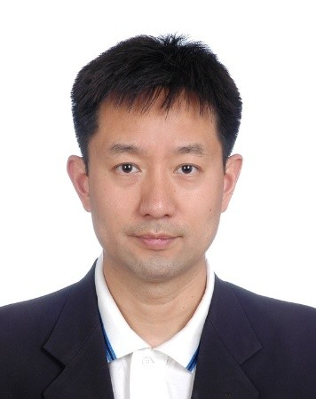
Key Experience
Product owner and engineering director of VxRail HCI product team at VMWare.
Was responsible for Life-Cycle-Management of VxRail with all VMWare stack in DC, private cloud and mixed cloud.
Closely mingled with sales, marketing and product managerment team in understanding customer requirement.
Managed a solution team for VxRail which is responsible for exploring various system integration/competition analysis.
Participated in annual VMW conferences and met customers.
Engineering head & release manager for Nimble Storage’s first generation AFA.
Worked closely with Nimble Product Management team.
Participated in regular seminar for sales and marketing people to update them with product details.
Participated in corporate events in meeting customers.
Be familiar with AFA & Nimble Infosight structure and impact to customer.
Engineering director at Data Domain and BRS division of EMC.
Be familiar with backup and data achieving use cases and solution.
Visit customer sites and talk to customers directly in both US and China.
Be speaker at various conferences and market fairs (EMC World, VMWorld, university events and technical conferences) including keynote speaker for “China Data & Storage Summit”
With MBA degree from UC Berkeley focusing on marketing and management.
Nelson Liao
ID: 00494311
VP of storage technology
Speciality:
Storage Life Cycle Management and IT Operation Management.
Hyper Converged Infrastructure (HCI) & Software Defined Storage (SDS).
Private Cloud and mixed cloud integration.
Hypervisor & VM use scenarios.
Dept.:
Futurewei Storage and Computing Division
Communication Level :
CxO, VP, Strategy Manager, Architect, HW/SW Engineer, Procurement/Sales Team, Consulting Company, etc.
Outstanding contributions
Worked at Data Domain, EMC, Nimble Storage and VMWware before joining Futurewei.
Joined Futurewei to lead efforts to build new IT & Operation Management framework.
Strong experiences in system management & many years of IT R&D experiences.
Ready for Support
Familiar with ITOM and telemetry of storage systems.
Familiar with product from other venders.
With many years of IT R&D management and product background.
With US Citizenship and excellent communication skill in both English and Chinese.

Slide 5
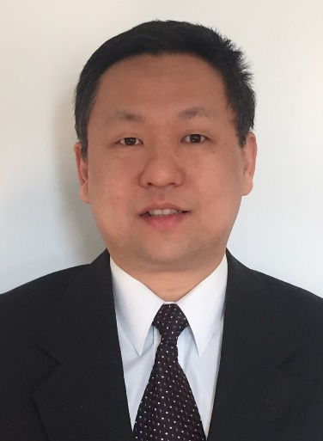
Key Project Experience
More than 13 years of storage industry experience. Architect and build mission critical storage software. Focus on the area of business continuity and data protection.
Had telecom industry experience on circuit provisioning, billing applications.
Support numerous enterprise customers across continents including Europe, Asian and US.
Contribute to Huawei storage’s major technical architectures – Frontend AA (Dorado), FusionStorage (ROC), Big Data Platform Accelerator.
Led Huawei’s storage native hybrid cloud project.
Dr. Ning Wu
Outstanding contributions
ID: 00412114
Principal Architect
Speciality:
Enterprise Storage Solutions (AFA, etc)
Distributed/SDS Solutions
Business continuity and data protection
Hybrid cloud solutions
Dept.:
Futurewei Storage and Compute Division
Communication Level :
CxO, VP, Strategy Manager, Architect, HW/SW Engineer, Procurement/Sales Team, Consulting Company, etc.
Customer Value & Huawei Value:
Strong Technical Background with Deep Understanding of Huawei’s Current IT and Storage Product Line
Principal architect of Futurewei Storage Lab
Extensive customer support experiences
20 years of IT industry Working Experience
Ready for Support
Deep understanding of Huawei Product offerring and technical details.
Previous sales and technical support experiences.
US citizen.
Excellent communication skills in English and Chinese.

Slide 6
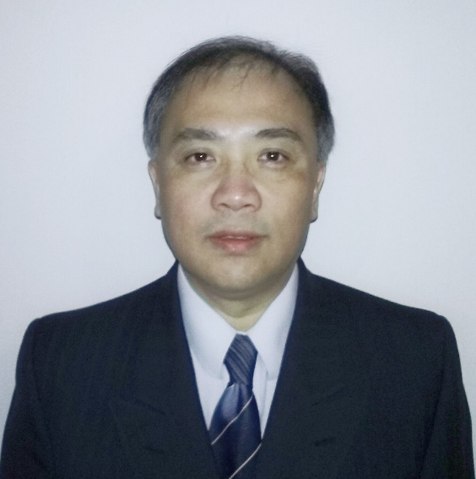
Key Domain & Key Project Experiences
20 years of storage industry experience. Architected and built distributed and highly scalable storage software. Focus on IT, Storage, Cloud, and AI pipeline infrastructure management, control and serviceability.
Had industry experience in IT management software in Health Care and Scientific Instrument industries, understand customer needs well.
Support numerous enterprise customers across continents including Europe, Asian and US.
Other than storage management, have been working on AIOps, AI Pipeline Infrastructure, Big Data Analysis recently for the last several years, understand well on customer needs in those areas as well.
Outstanding contributions
Yong Wang
Strong Technical Background with Deep Understanding of Huawei Current IT and Storage Product Line
Lead and major contributor to Huawei and Futurewei projects: Wenju AI Pipeline, Big Data and AI Platform Acceleration, AIOps SSD Deap Learning failure prediction, Dorado management path backend re-architecture.
Working as a Principle Architect for U.S. storage vendors EMC and HPE-SimpliVity for many years with extensive customer support experiences, especially in IT and storage management, abstraction, orchestration and automation
Over dozen software Patents filed in the U.S. relate to Storage Industry
ID: 00411939
Senior Architect
Speciality:
IT, Storage, Cloud, AI, Big Data Analytics, Infrastructure Management
Dept.:
Futurewei Intelligent Data and Computing Lab
Communication Level:
CxO, VP, Strategy Manager, Architect, HW/SW Engineer, Procurement/Sales Team, Consulting Company, etc.
Ready for Support
Deep understanding of Huawei Product offerring and technical details.
Previous sales and technical support experiences.
US citizen.
Excellent communication skills in English and Chinese.

Slide 7
Q&A for Huawei Storage First Two Courses Boston Storage Solution Group May 2020
Notes:
Good morning, good evening and good afternoon everyone.
Welcome to Huawei Storage Technology Deep Dive.
This is Nelson Liao, the VP of Technologies at Santa Clara Storage Lab, which is also part of the Futurewei Boston Storage Center. It’s my honor to host today’s deep dive session. Before

Slide 8
Huawei’s Company and Storage Business Overview: Why 18+ years?: if Huawei-Symantec was Acquired in 2012, and Founded in 2008
Huawei’s Technology Vision and Key Storage technologies: When is really possible to talk of “4 in 1” Storage (Blocks, Files, Object, HDFS) Solution?

Slide 9
Storage Product and Solution Portfolio Review: Should we also show eSight, and Fusion Insight?
Broadcom (Brocade) and Commvault are relationships fully recovered?

Slide 10
Fusion Cube and HCS current development status? “Native” Integration with other brands Public Cloud
Global Customer Support Infrastructure: Can TACs and SLCs be highlighted in Colombia (South America)?

Slide 11
Automated Data Management: How to define DMS?
Would like to understand how products like OceanStor 100D & OceanStor 9000 are positioned in different customer and application scenarios. Could you give more examples?

Slide 12
Could you help us understand how we accommodate block, file and object into one storage pool. Does the storage system store in object or block?
How are we going to implement free data flow between edge-central-cloud (hybrid, multicloud solutions) and also between our different storage platforms Dorado-100D-FusionCube?

Slide 13
Explanation, future work with the ecosystem of infrastructure partners and application vendors using APIs, Kubernetes, Ansible, OpenShift, Containers.
How we are going to fit with modern data centers with automatic deployment & management software defined and services drive?

Slide 14
What is the highest recommended DRR, for an evaluation-free offering? 2.7:1? Or is feasible go further 4:1 5:1?
When / where start to make sense to use “Huawei Data Reduction Estimation Tool.zip”?

Slide 15
Six nines is our current offering for OceanStor V5 System, and the same for OceanStor Dorado V6 System?
Considering a third DataCenter, or Cloud Backups, etc. how many nines should we offer? You know, HDS continue talking of 100%

Slide 16
Knowing that they have different functionalities and scopes… Is there a thumb rule for positioning eSight or OceanStor DJ (DMS)?
What are the boundaries between Device Manager, OceanStor DJ, eService and eSight?

Slide 17
What software does Huawei storage use to manage storage system at data center and multi data center levels?
What is AIOps? How does Huawei Management stack fit into such technologies?

Slide 18
It is quite interesting to notice that no other vendors yet support the feature Disk Risk Prediction, can you tell us what to take to make that work?
It was mentioned how DME could become the center piece of the Automated Data Management, can you give a concrete example how the DME will work?

Slide 19
One reading the Dorado V6 may be impressed that the one of the key SSD innovation called redirect on write (ROW), can anyone outline at least two major benefits of this ROW tech?
With RoW, one can see that the write amplification ratio for random IO is as low as sequential write on the RAID system, can one elaborate how such performance can be achieved?
How Dorado V6 guarantee the data integrity (say the node dies before writing data in cache to SSD)?

